Slide 1
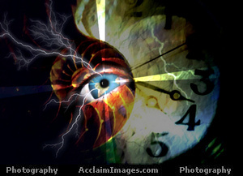
City of Nedlands
Leadership
10 March 2016
Perth W Australia
Our Future :
Frightening & Fantastic
Annimac / Anni Macbeth
Futurist & Trend Forecaster www.annimac.com.au

Slide 2
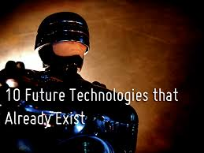
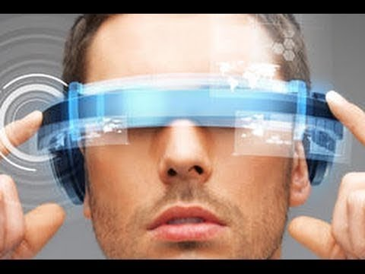
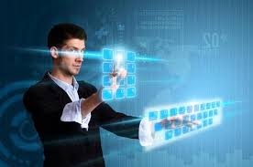
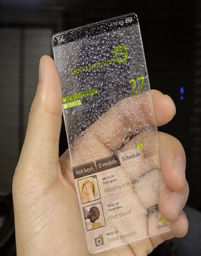
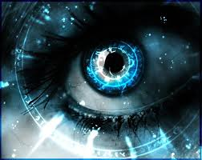
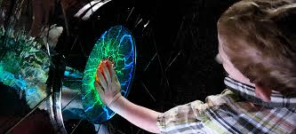
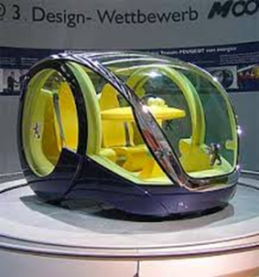
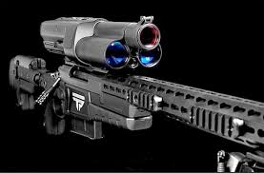
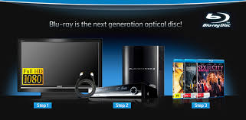
Exponential change
Augmented Reality
Quantum energy
Bionic Eye
Driverless
Smart machines

Slide 3
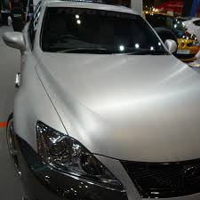
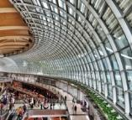
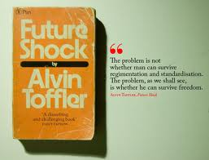
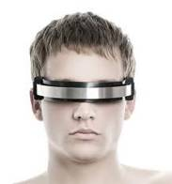
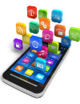
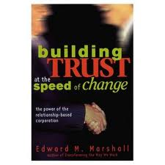
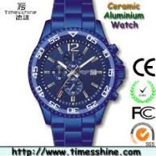
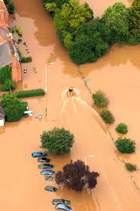
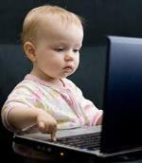
Exponential speed of change
Smart buildings
Climate

Slide 4
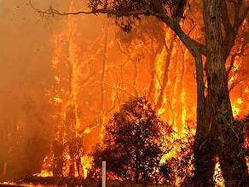
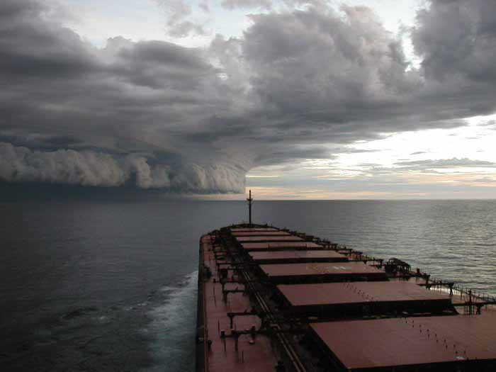
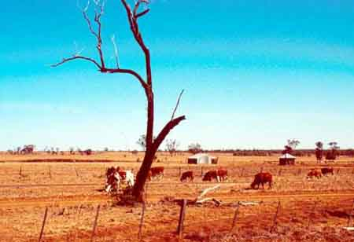
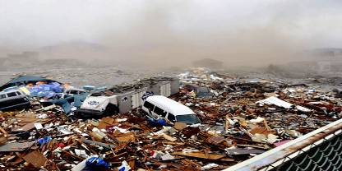
Unpredictable Severe Climate Change
Urban forests plan to cool cities
Faced with the prospect of rising global temperatures and higher density living, Perth councils are taking steps to protect their trees.
Some, such as the cities of Vincent and Bayswater, have set targets to increase their tree canopy.
Others, such as the cities of Perth, Armadale and Belmont, have commissioned urban forest strategies to guide future tree numbers, type and location
West Australian 20/10/14

Slide 5
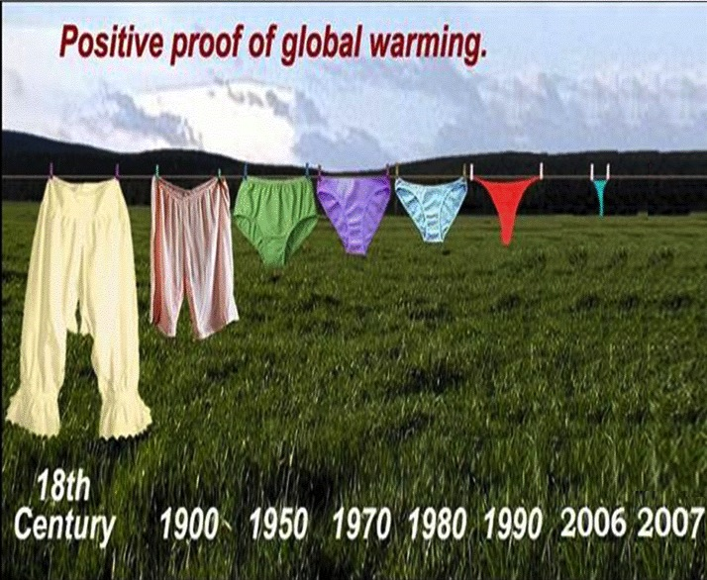
Positive proof of global warming

Slide 6
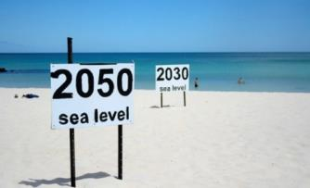
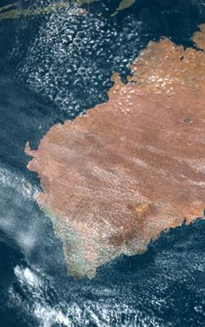
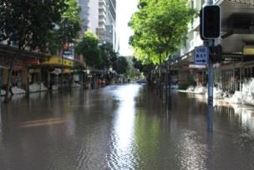
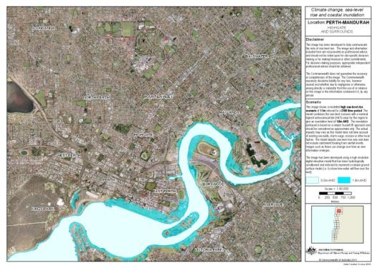
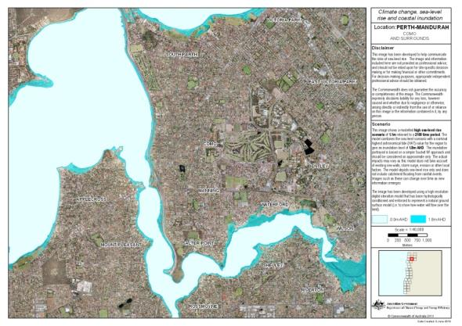
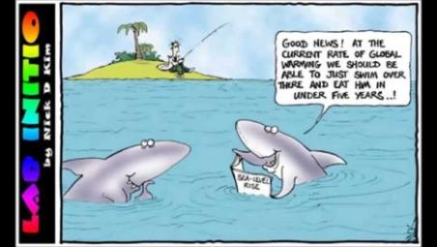
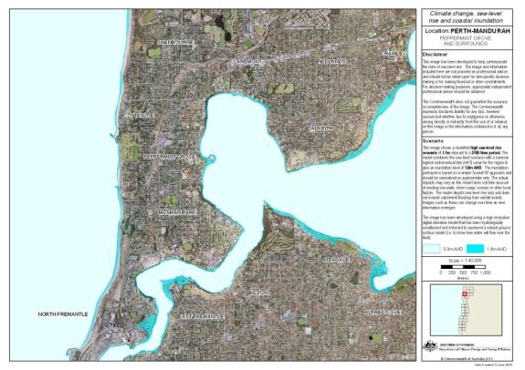
Rising Sea Levels
Brisbane 2011
2165
Perth In 80 years ?

Slide 7
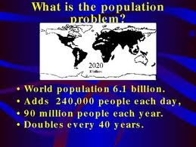
Population vs Resources
Changing demographics:
60% world pop now sub replacement
Ageing Pop : costly
97% of water on Earth is undrinkable
2016: 7.4 billion

Slide 8
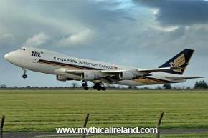
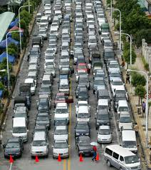
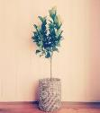
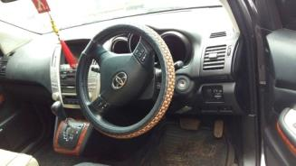
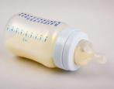
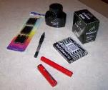
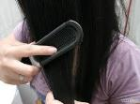
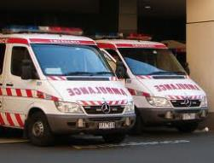
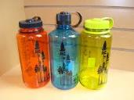
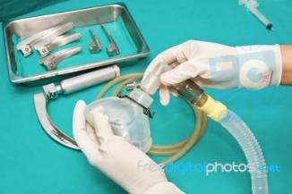
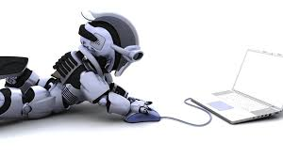
Peak Oil Oz 2000
Transport costs soar
Queue for petrol - California
Petroleum products: furniture textiles computers iphones pharmaceuticals clothing cars ….
Grounded

Slide 9
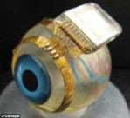
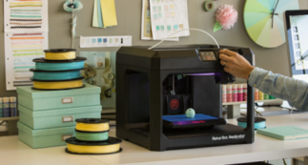
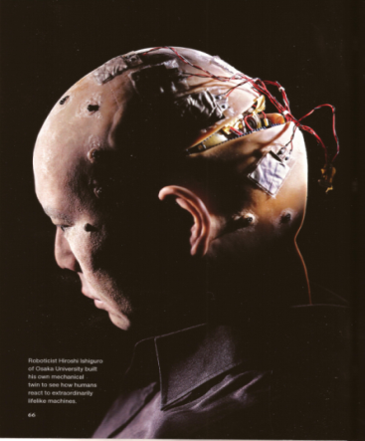
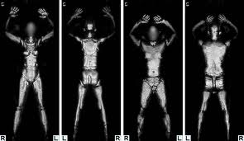
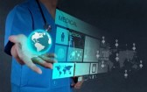
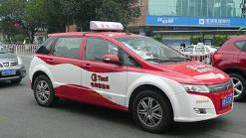
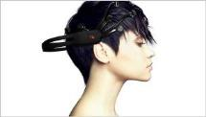
Technology
9
Notes:
9

Slide 10
Technology & Worklife
Online comms
Automation
Big Data analytics
3-4D Printing
Augmented Reality
coming :
Hologram
wristband
with full
interconnectivity

Slide 11
Technologies Trends
2020 10 x better than 2015
2025 100 x better than 2015
mobile interconnectivity now
65% world pop mobile phones 1995: 3%
1.4b use Facebook 2006: 6m GenZ
intelligent cities
office : network of people
not a fixed place
robotics / enhanced humans

Slide 12
3D / 4D Printers
coming Hologram/wristband
full interconnectivity

Slide 13
Crowd funding now : Indiegogo
Palm-Sized Drone With GPS Auto-Follow and High Res Video Camera
Cat robot : play & track
Go Pro 3-axis gimbal with Bluetooth
Thumbprint lock
TV Projector 180” screen
AIDO home robot

Slide 14
Who is
Driving
change
Baby boomers 1945 -1965
Gen X 1965 - 1980
Gen Y 1980 - 1995
Gen Z 1995 - 2010
From 2010 :
Age 50 - 70
Age 35 - 50
Age 20 - 35
Age 5 - 20

Slide 15
b 1995 - 2010

Slide 16
Generation Z b1995-2010 age 5 - 20
The Influencers

Slide 17
Digital in their DNA
2 billion entered workforce in 2015
largest cohort group in world
breaking the generations
hyperconnected
from Affluencers GenY to Influencers GenZ
sling shotting technologies

Slide 18
Gen Z & Work
v conservative v serious
v ambitious v principled
ignore obstacles ignore status
live intelligent cities
live mobile interconnectivity
network people
personalised messaging
reject idea of fixed place
expect robotics / androids

Slide 20
Gen Z in Oz

Slide 21
Thriving now into your future
Organisational mind set
Remain agile Flexible
Responsive to clients & ratepayers
Collaborate creatively Proactively
Attitude required :
Personal responsibility for change
Values required:
Integrity
Social responsibility
Transparency

Slide 22
To Succeed into the Future

Slide 23
Thank you contact me www.annimac.com.au

